Slide 12
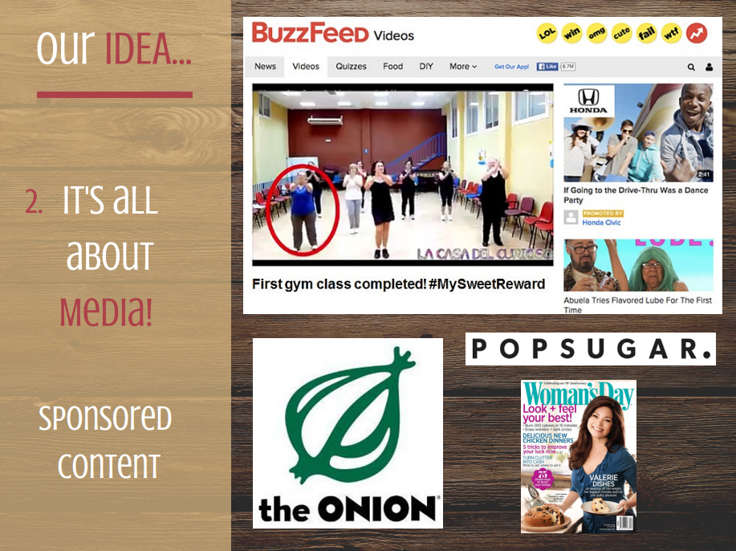

Slide 19
Item | Quantity | Cost | Comments
Media Kits | 200 | $15,000 | plus samples and coupons
Half Marathon Sponsorship | 3 | $30,000 | plus samples and coupons
Fitness Events | 3 | $5,000 | plus samples and coupons
Contest Videos | 6 | $30,000
Contest Prizes | 12 | 12,000
Snapchat Filter | 6 events x 5 hours | $1,000
TOTAL |  | $93,000
Sponsored Content |  | $30,000-$100,000 | Optional

